Slide 1


Design Guideline-
FRUNK
Tushar Shimpi & Anurag Chavan
8th October 2025

Slide 2

TABLE OF CONTENTS
Technical Description
System interfaces
Materials & Weights
Requirements
Assembly flight path
Engineering packaging sections
Location and fixation strategy
Frunk storage items

Slide 3
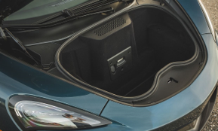
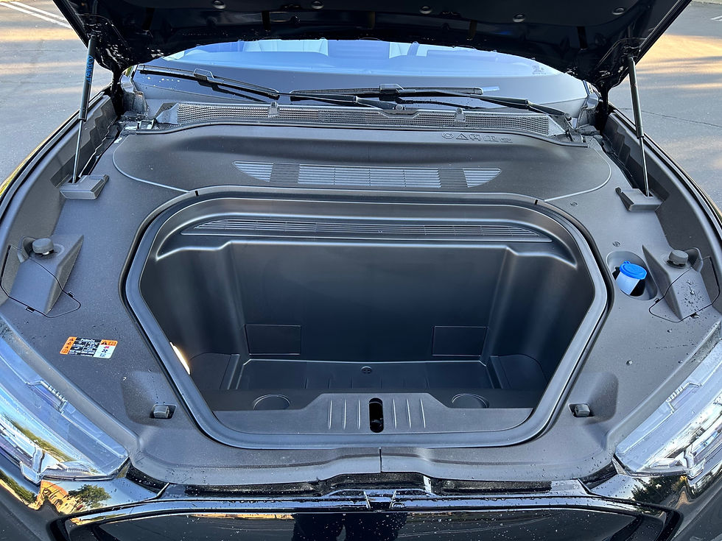
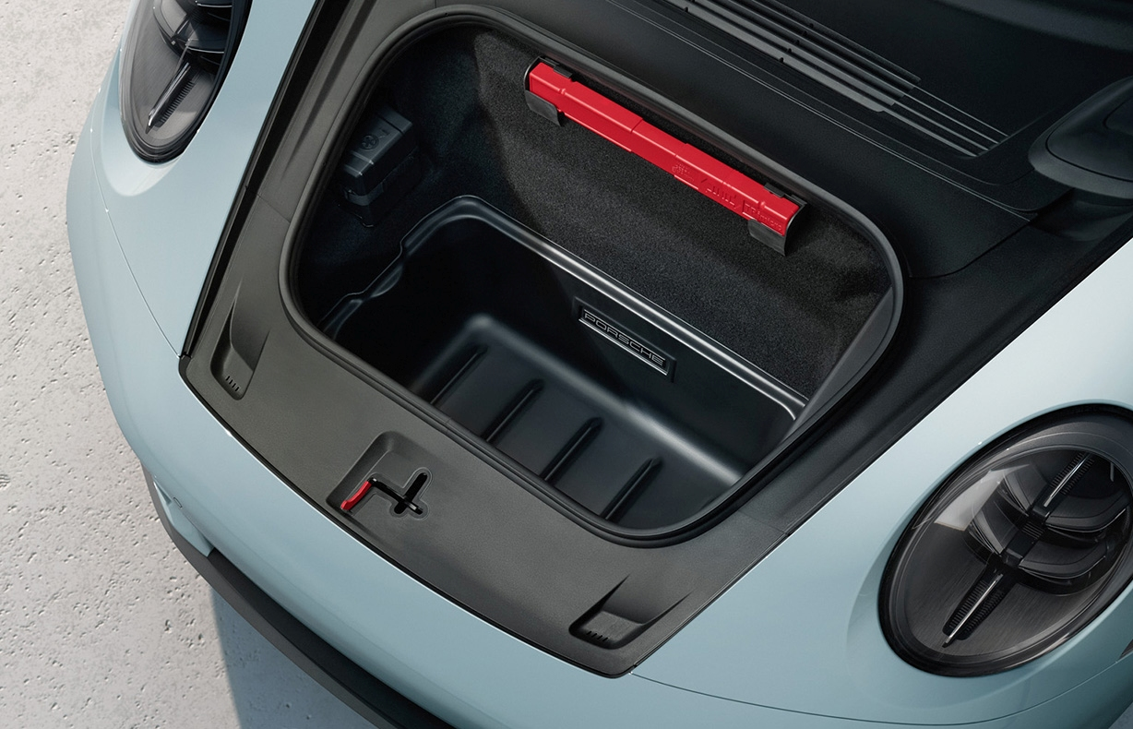
Technical Description
The term “frunk” is a unique portmanteau, blending the words “front” and “trunk” to create a new concept. This innovative term has gained popularity in the context of electric vehicles (EVs), where it refers to the forward-found storage compartment.
Frunk is an enclosed storage compartment located near the front of the vehicle under the bonnet.
Primary Function of frunk is for simple stowage of charging cables.
Secondary Function is for the stowage of Jack/Toolkit, emergency equipment (warning triangles, first aid kit, etc.), additional stowage.
Mclaren 570 GT
Mustang Mach – E
Porsche 911

Slide 4
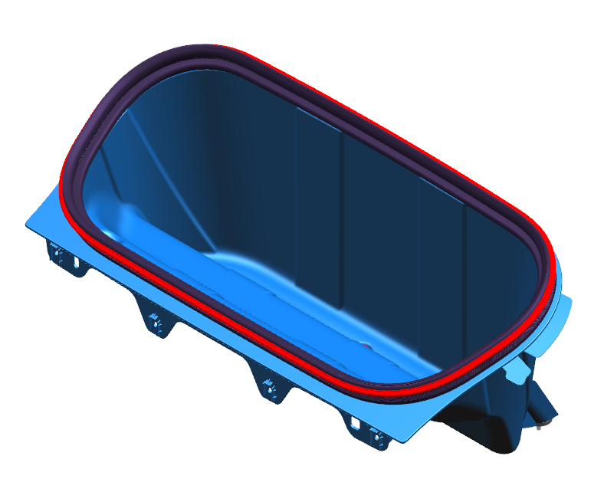
SYSTEM INTERFACES
Pumps/Hoses
Hood Panel
Bonnet Lower
Beautification Cover
Front End Carrier
Upper mounting bracket
Charging Cables
Beautification Cover Front
High Voltage Tray
Cooling Duct
Upstream Duct

Slide 5
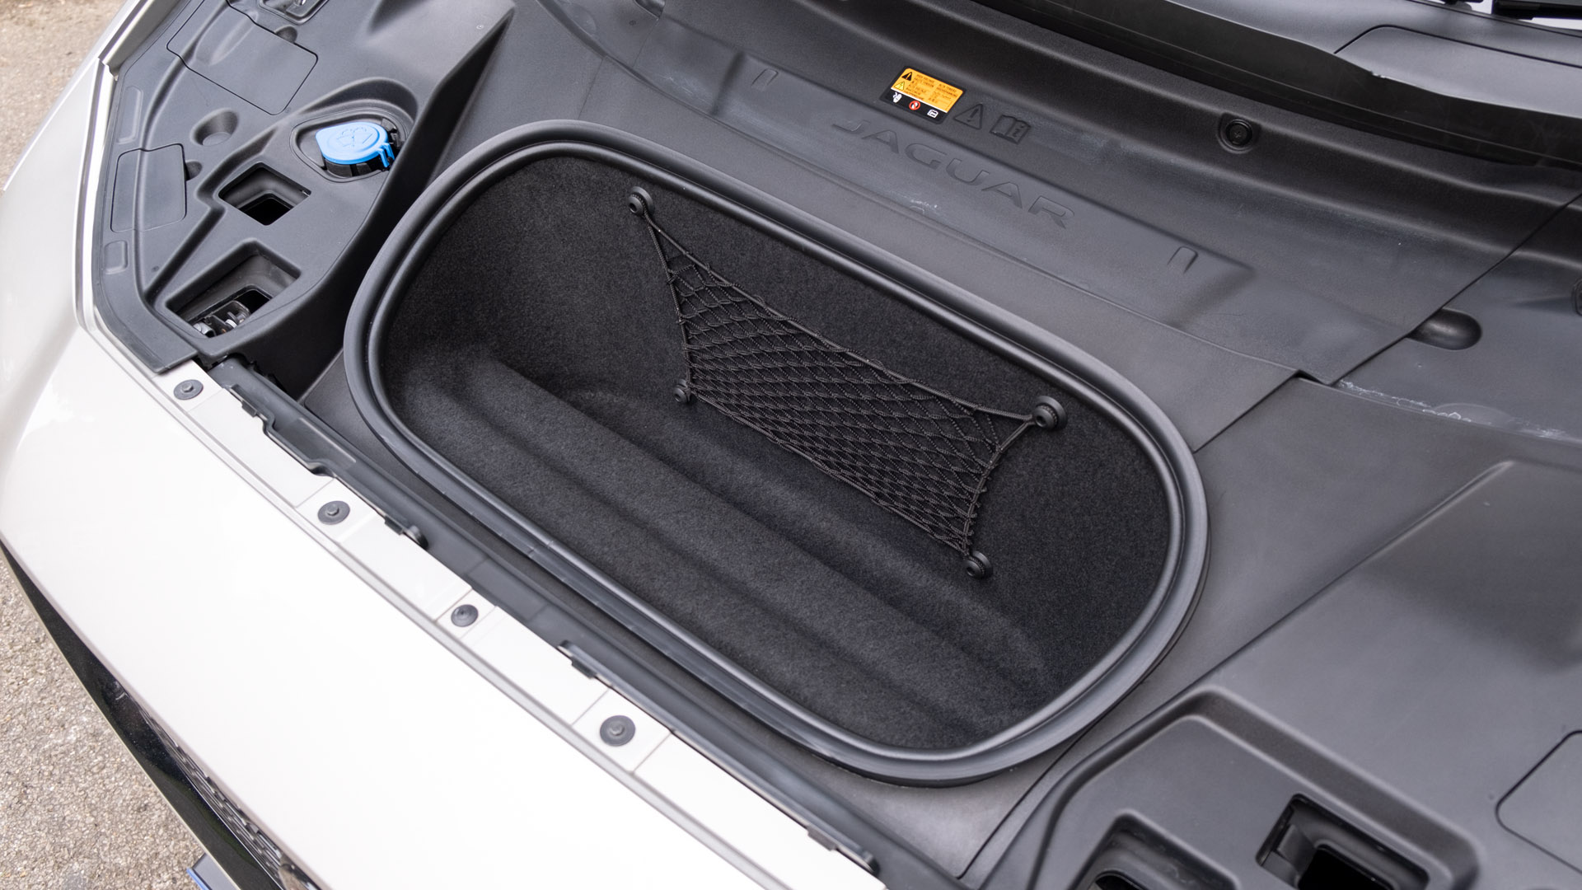
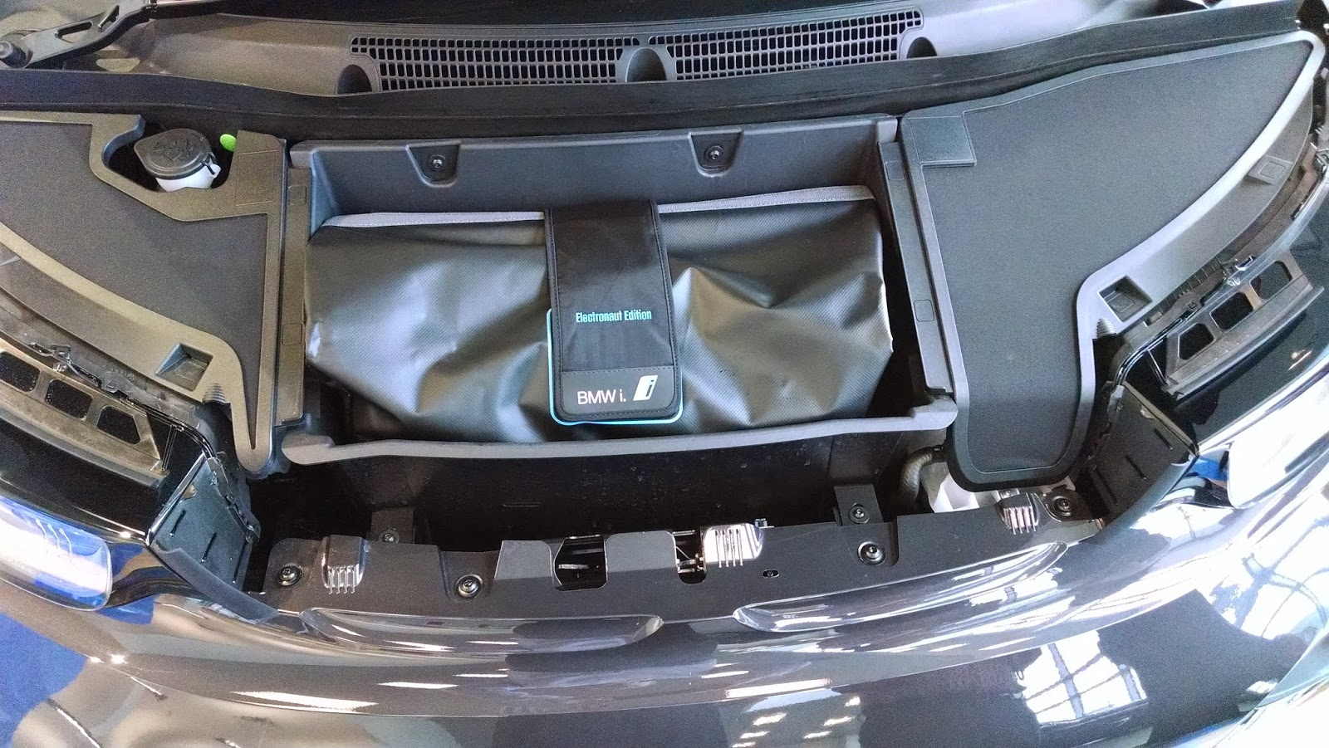
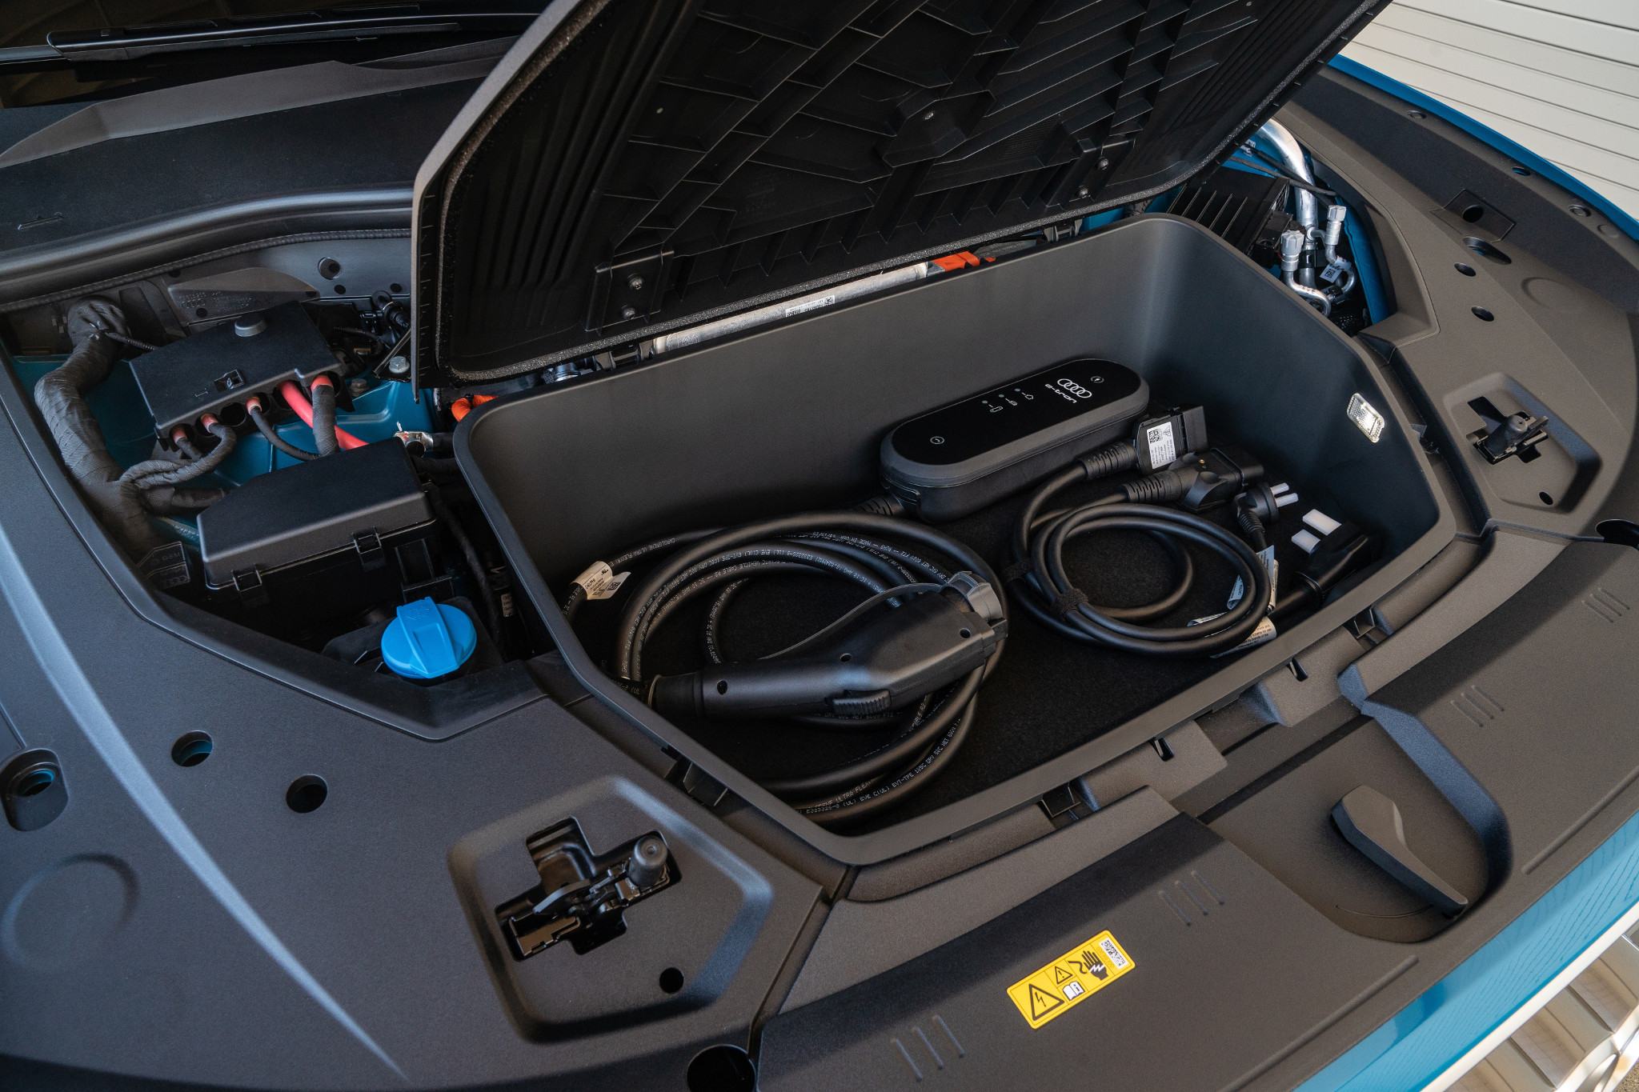
MATERIALS & WEIGHTS
Vehicle | Frunk | Material | Weight | Volume
I Pace (X590 18MY) |  | Seal: EPDM Carpet Insert: 360gsm >PET< + 800gsm >PP< formed carpet Mold: 30% Glass Reinforced Polypropylene >GRPP< | 1.609 kg | 27 liters
BMW i3 14MY |  | >PA6-MX.GF30< | 2.203 kg | 58.8 liters
Audi e-tron 19MY |  | Plastics > PP >PP-PE-TD20< | 2.759 kg | 60 liters

Slide 6
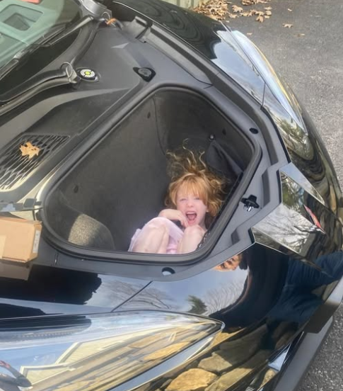
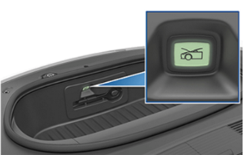
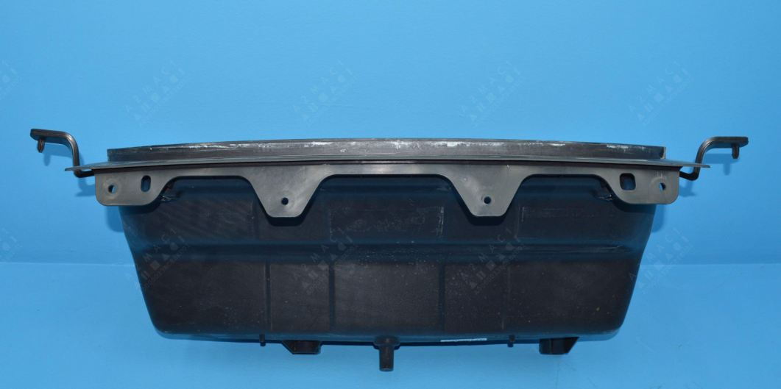
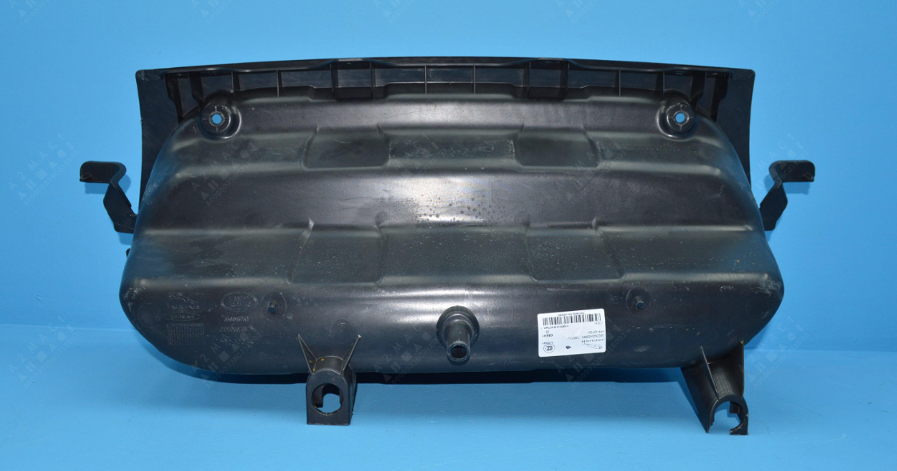
REQUIREMENTS
Internal release mechanism:
FMVSS (Federal Motor Vehicle Safety Standards) are U.S. regulations that mandate minimum safety requirements for vehicle design, construction, and performance.
To ensure that person trapped inside the trunk of a passenger car can escape safely by using an internal release mechanism – using switch.
Example: Tesla Model 3 : An illuminated interior release button inside the frunk allows a person locked inside to get out. Press the interior release button to unlatch the front trunk, then push up on the bonnet.
Interior release button : Tesla Model 3
Consider the position of the drain hole:
Position it so that water won't flow onto any electrical components.
Avoid placing it above items that could trap or collect draining water.
Choose a flat surface that sits at the lowest point in the area, even if it's not lower than everything else.
Ensure that there is a plug so that water can be drained, but not allowed in.
Frunk: Jaguar I pace ev400 2019

Slide 7
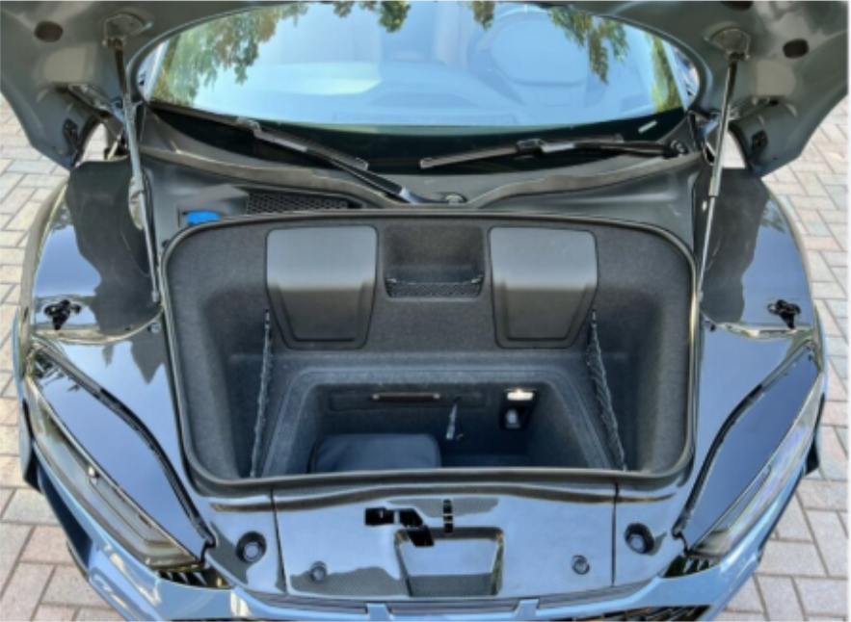
Requirements
Requirement of light source:
To enhance the usability of the frunk as a storage space, consider integrating a light source either within the frunk or on the underside of the bonnet to ensure adequate illumination.
Light Distribution-The lighting shall be bright and uniformed enough for the user to be able to see the complete depth and width of frunk area. Illumination of the feature must be measured in Lux and for harmony purposes, the uniformed output of the illumination shall be an average of 8 Lux ± 30 % for up to 64 liters capacity and 10 Lux ± 30 % for over.
Lamp Positioning- Lamp to be positioned such that it meets the light distribution as specified above. Competitor benchmarking shows this does not need to be @Y=0. Lens optics can be tuned to account for lamp offsets.
E.g. Tesla Model S(1), Tesla Model X(2), Porsche 911(1), Porsche Cayman(1), Audi R8(1)
Frunk: Audi R8 Gen 2

Slide 8
REQUIREMENTS
Storage Space:
Design a dedicated storage compartment within the vehicle for charging cables that ensures easy accessibility, protects the cables from damage, and prevents tangling during storage and retrieval. Consideration of human factors is essential to enhance usability and convenience.
Seal Requirements:
Seal must be watertight to ensure protection against water ingress, dirt ingress over time and meet industry standards for competitiveness with other automotive brands.
Carpet Requirements:
Carpet material, finish and fit must meet or exceed the quality standards of premium segment vehicles to remain competitive with other high-end offerings. The carpet must be dark in color to maintain a premium appearance and conceal dirt or wear.
Heat resistance from motor:
The frunk compartment must be thermally insulated from adjacent heat- generating components such as the motor, inverter or power electronics. Materials and design must prevent heat transfer that could raise frunk temperatures beyond acceptable limit, ensuring safety, durability and protection of stored items under all operating conditions.
Bonnet Interface:
The frunk must interface seamlessly with the bonnet, ensuring uniform gap and flushness, effective sealing against water and dust ingress, and structural compatibility with latch, hinges and support components. The interface should also support NVH performance and meet exterior fit and finish standards.
Minimum radius of Seal:
The frunk seal must have a minimum bend radius of ≥ 100 mm to ensure consistent compression, long term sealing performance, and resistance to material fatigue. The seal geometry should be compatible with manufacturing and tooling limitations, avoiding sharp corners or tight radii that could lead to tearing, poor fitment, or increased tooling wear.

Slide 9
REQUIREMENTS
General clearances with surrounding parts:
Wire harness clearance with Frunk minimum 6mm.
Kinetic pipes, D gas tank, Brace bracket, Fastner etc. clearance with Frunk minimum 10mm.
Bonnet inner min. 25mm

Slide 10
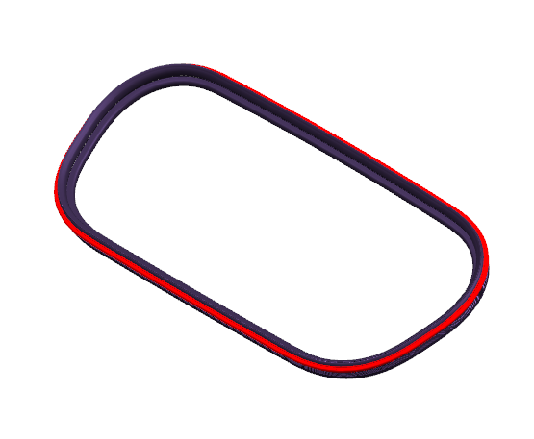
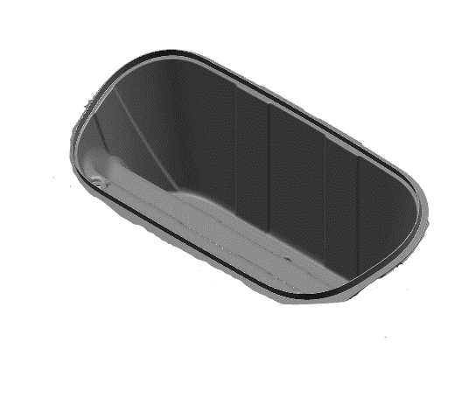
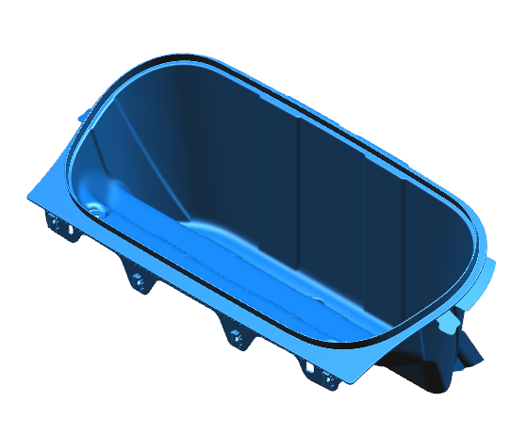
Assembly flight path
Assembly Sequence of Frunk :
1. Main Mold Preparation
The frunk’s plastic or composite shell is cleaned and inspected. Mounting points are checked for proper fitment.
2. Carpet Installation
Carpet liner is fixed inside the mold using clips, adhesives, or fasteners. This adds insulation and improves appearance.
3. Seal Assembly
A weatherstrip seal is installed around the mold’s perimeter to prevent water and dust ingress. It may be press-fit or bonded.
4. Frunk Sub-Assembly Completion
With carpet and seal in place, the frunk mold becomes a complete sub-assembly.
5. Installation onto BIW
The frunk sub-assembly is mounted onto the BIW using bolts, clips, or brackets. Final inspection ensures proper alignment and sealing.
3
ASSY IN Z-DIRECTION
Seal
2
ASSY IN Z-DIRECTION
Carpet
1
ASSY IN Z-DIRECTION
Main Moulding
FRUNK LOADED/ASSEMBLED IN Z-DIRECTION
Frunk

Slide 11
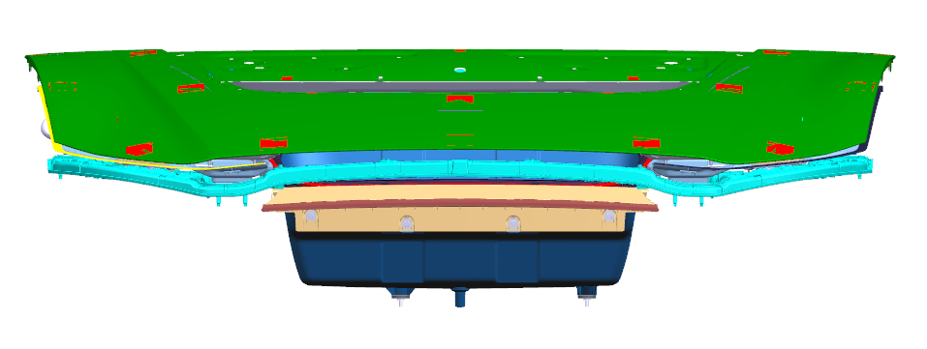
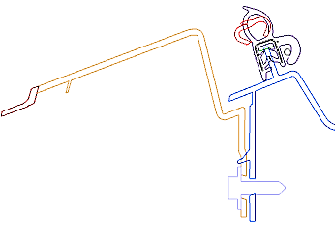
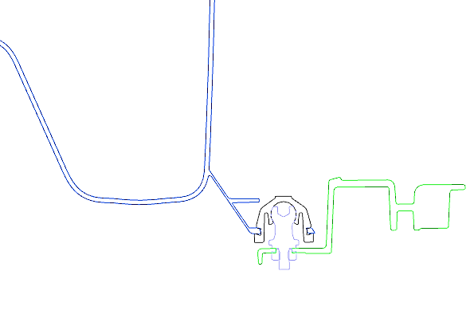
ENGINEERING PACKAGING SECTIONS
A
Highlighted area shows fixing with beautification panel.
Highlighted area shows fixing with high voltage tray
B
A
B
Frunk:
Frunk is attached to beautification panel using 4x push in plastic pins.
Cruciform locator features into front end carrier.
Fixing with high voltage tray should be used at 3.2 Nm torque to avoid cracking of fixing.
2x fixings from frunk moulding to upper mounting bracket.
Section A-A
Section B-B
For Fixation and Location strategy please refer next slides.

Slide 12
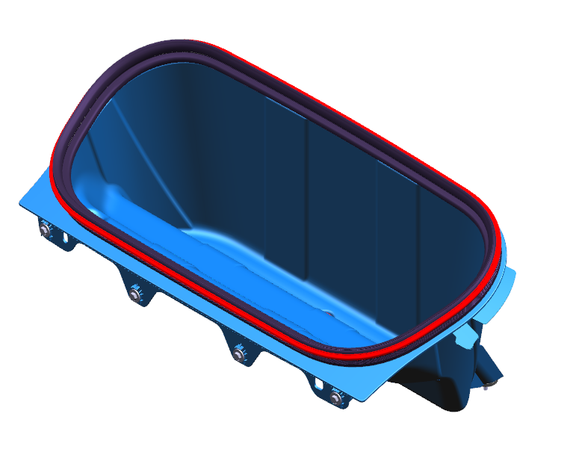
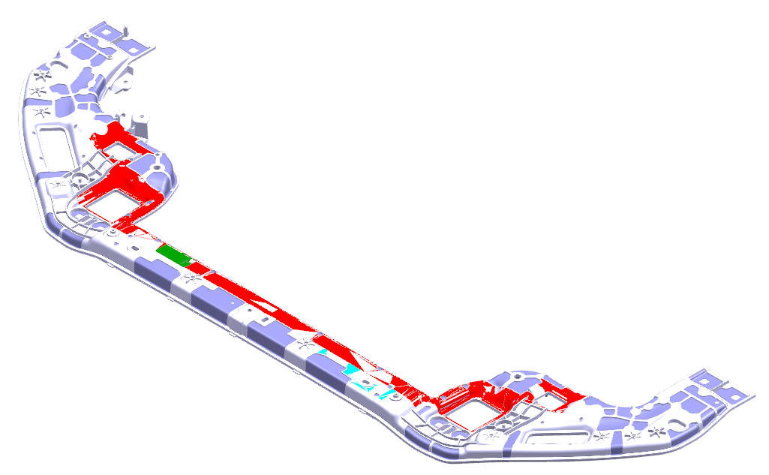
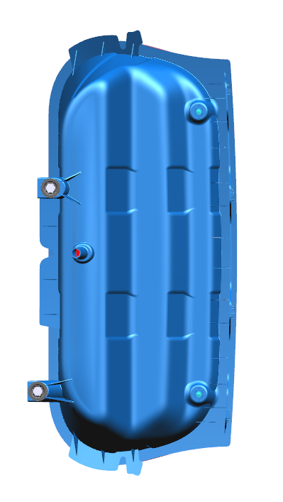
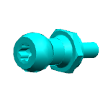
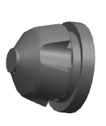
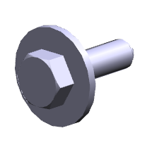
Location & fixation strategy
Frunk Fixations-
Snaploc Fixings provide the primary locator features into HV Tray acting as a 4w and 2w respectively.
Frunk assembles with
Front End carrier
Beautification panel
High Voltage tray
4 fixings into beautification panel
2 fixings into upper mounting bracket
SCREW&WSHR M6X20 HX PIL8
Knee Screwed Dowel
Rubber Coupling
1. SCREW&WSHR M6X20 HX PIL8
Four positive screws with washer fixed with BEAUTIFICATION PANEL.
2. Knee screwed Dowel
TWO screws fixed with High voltage tray
2 Snaploc fixings into HV tray
Snaploc Fixings provide the primary locator features into HV Tray acting as a 4w and 2w respectively

Slide 13
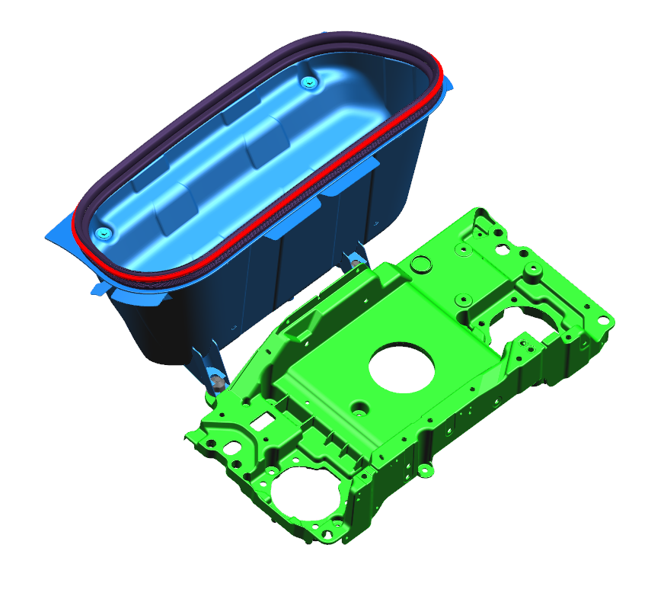
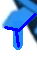
Location & fixation strategy
It should meet 3-2-1 principle.
Use similar fasteners at all places if possible.
Use standard fasteners at all places.
Based on part size, 2 locators are added.
Ensure that all holes and fixings are correctly aligned.
Ensure that the correct hole size is in place for each fixing, accounting for material and thickness.
Ensure that the correct torque is listed for the fixing and material combination.
2 x M06x20.0 bolts fixing Frunk Moulding to Upper Mounting Bracket
2 x Bollhoff Snaploc fixings fixing Frunk Moulding to High Voltage Tray

Slide 14
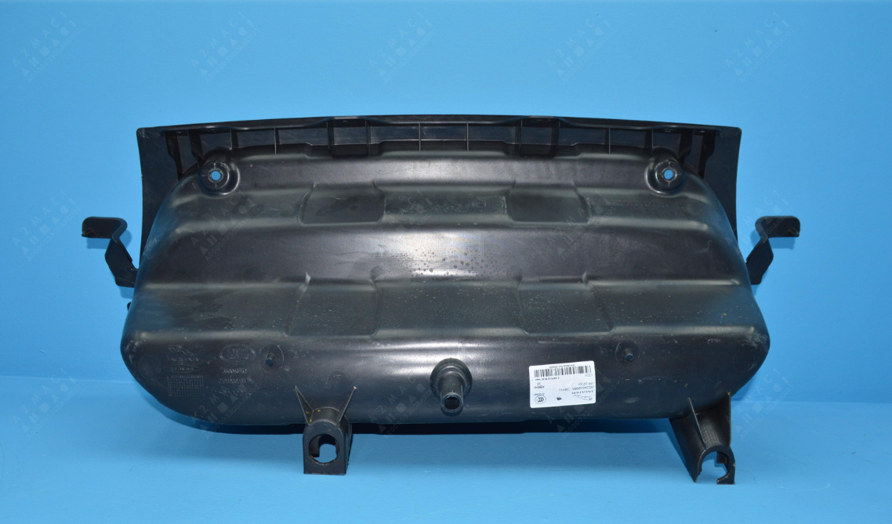
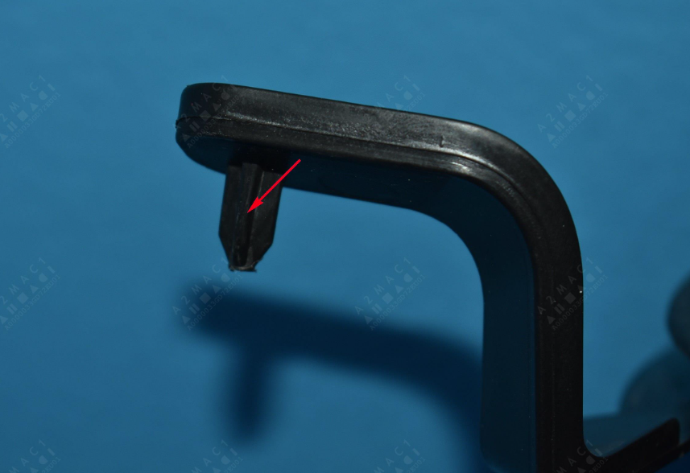
Location & fixation strategy (jaguar I pace ev400 2019)
4 way Locator
2 way Locator
2 way Locator

Slide 15















Frunk Storage items
A. Low Usage Frunk Items
B. Medium Usage Frunk Items
C. High Usage Frunk Items
Charging cables- Unwound as well as wound.
Emergency kit e.g., High Vis, Warning triangle, First aid kit etc.
Maintenance items e.g., De-icer, Wiper fluid etc.
Towing eye and tow rope
Winter kit e.g. Snow chain, shovel, blanket etc.
Outdoor wear e.g. Walking boots, waterproof jackets, dirty items etc.
Emergency water
Sports bags and items.
Beach gear.
Small shopping items.
Groceries.
Suitcases (flight bag and larger)
Sports equipment e.g., Rackets, bats etc.
DIY e.g., Tool kit, paint cans, cement etc.
Children’s balance bike
Folding bike
This is a guideline.
Programme team to advise what items to be stowed in a particular vehicle

